Slide 1
Dynamics of Fluid in Porous media
Fluid Mechanics II
Advanced Fluid Dynamics

Slide 2
Porous Media
Definition
  A porous medium can be defined as anything that is comprised of a solid matrix and voids or simpler a material that contains pores.
  That, it is a body composed of a persistent solid part, called solid matrix, and the remaining void space (or pore space) that can be filled with one or more fluids (e. g. water, oil and gas). Typical examples of a porous medium are soil, sand, cemented sandstone, karstic limestone, foam rubber, bread, lungs or kidneys.

Slide 3
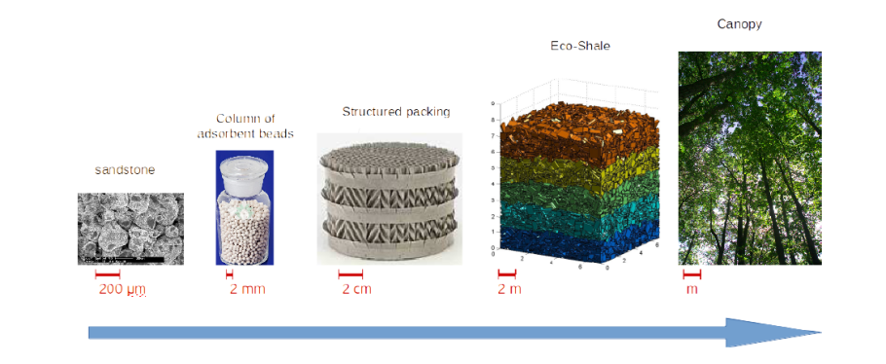
Porous Media
Definition

Slide 4
Porous Media
Definition
  A phase is defined in as a chemically homogeneous portion of a system under consideration that is separated from other such portions by a definite physical boundary.
      Single–phase system the void space of the porous medium is filled by a single fluid.
      Multiphase system the void space is filled by two or more fluids that are immiscible with each other, i. e. they maintain a distinct boundary between them (e. g. water and oil).

Slide 5
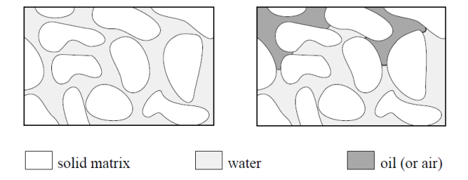
Porous Media
Definition
  Component to be part of a phase that is composed of an identifiable homogeneous chemical species or of an assembly of species (ions, molecules)
    The example of fresh and salt water given above is described by a single–phase two component system.

Slide 6
Porous Media
As shown on Figure void spaces can exist: A) between the particles that comprise the matrix (intergranular); B) within the particles themselves (intragranular); or C) due to secondary features such as fractures or root holes. Soil particles may be cemented (D) to one another. Particles may also be bound in aggregates (E). A porous medium can be defined as anything that is comprised of a solid matrix and voids.
Figure 1

Slide 7
Porous Media
In order to derive mathematical models for fluid flow in porous media some restrictions are placed upon the geometry of the porous medium:
    (P1) The void space of the porous medium is interconnected.
    (P2) The dimensions of the void space must be large compared to the mean free path length of the fluid molecules.
    (P3) The dimensions of the void space must be small enough so that the fluid flow is controlled by adhesive forces at fluid–solid interfaces and cohesive forces at fluid–fluid interfaces (multiphase systems).

Slide 8
Porous Media
  The first assumption (P1) is obvious since no flow can take place in a disconnected void space.
  The second property (P2) will enable us to replace the fluid Molecules in the void space by a hypothetical continuum.
  The third property (P3) excludes cases like a network of pipes from the definition of a porous medium.

Slide 9

Porous Media
The porosity,
  It is noted by n [L³ L⁻³]
  Porosity of a porous medium is defined as the volumetric fraction of the medium that is occupied by the voids:
  Where V_{v}, V_{s} and V_{T} are the volumes of the voids, matrix solids, and total medium, respectively.
(1)

Slide 10
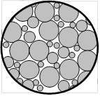
Porous Media
  The porosity also defines the average fraction of a cross section through a medium that is occupied by voids.
  The fraction of the area occupied by voids is equal to the porosity.
Figure 2, Cross section of porous medium

Slide 11
Porous Media
  By definition, the porosity can only range from 0 to 1. (Note, Φ is also commonly used to denote porosity, will be used both notation ø and n.
  Typical porosity values [m³ m⁻³] for unfractured, unconsolidated geologic media are: gravel (0.25 to 0.40); sand (0.25 to 0.50); silt (0.35 to 0.50); and clay (0.40 to 0.70).
  The primary porosity of a medium occurs between the solid particles. Secondary porosity is caused by fracturing and dissolution.

Slide 12
Porous Media
  The primary porosity of a medium depends on the structure of the matrix, including the shapes of the solid particles, the distribution of particle sizes, the degree of compaction of the medium, and, to a lesser degree, the average size of the solid particles.
Figure 4. Typical grain packings

Slide 13
Porous Media
  Sorting describes the range of sizes of the matrix solids. In a perfectly sorted medium, all of the matrix particles have the same diameter.
  The more poorly sorted a medium, the more efficiently the particles can be packed, leading to a decrease in the porosity of the medium.
  Some of the pore space (such as intragranular porosity) is not connected.

Slide 14


Porous Media
  The effective porosity, n_{e} [L³ L⁻³], describes only that porosity that is connected, allowing for fluid flow through it and is defined as:
  Where V_{vc} is the volume of the connected voids.
  The void ratio of a medium, e [L³ L⁻³], can also be described as:
(2)
(3)
Unlike the porosity, the void ratio can be greater than one. This parameter is used more often in engineering applications.

Slide 15
Porous Media
  Water, gases, and dissolved compounds travel predominantly through soil voids.
  Note from Figure 4 that the shapes and distributions of the pore spaces change with the packing, shape, and degree of compaction of the soil particles.
  This clearly impacts the average length of the path that a water, gas, or solute particle must take to travel between any two points that are separated by a fixed distance.

Slide 16
Porous Media
  The ratio of the average travel path to the distance of separation is known as the tortuosity, t [L L⁻¹]. A medium with a high tortuosity has a more convoluted, less well-connected pore space.
  The specific surface area [L² L⁻³] describes the area of the interface between the matrix solids and the void space per unit volume of porous medium.
  The value of this property increases with the roughness of the surface of the particles and with a decrease in the size of the particles.

Slide 17

Porous Media
  The void spaces in a porous medium can be filled with a variety of fluids. Commonly, water and air fill most of the pore space.
  The volumetric water content, ө [L³ L⁻³], of a medium is defined as the ratio of the volume of water, V_{w}, to the total volume of a sample, V_{T}:
  The maximum volumetric water content of a medium is equal to the porosity.
(4)

Slide 18


Porous Media
  The fraction of pore spaces that are filled with water is known as the water saturation, S_{w}, and is defined as the ratio of the volumetric water content to the porosity:
  Fluid contents and fluid saturations can be calculated in a similar manner for any fluids within the soil pores.
  Gravimetric water content, ө_{g} [M M⁻¹], of a medium is equal to the ratio of the mass of water in a sample, M_{w}, to the mass of the oven-dried soil, M_{s}:
(5)
(6)

Slide 19

Porous Media
  The bulk density, ρ_{b} [M L⁻³], of a porous medium is equal to the ratio of the total mass of a sample to its total volume.
    Considering a medium with only air and water in the pores, the bulk density is then equal to the following composite of the densities of the medium components:
(7)

Slide 20


Porous Media
  The dry bulk density, ρ_{bd} [M L⁻³], of a medium is defined as the mass of the soil solids in a sample divided by the sample volume:
  Volumetric water content can be related to the gravimetric water content as:
(8)
(9)
For most soils, the dry bulk density is greater than one, so the gravimetric water content is lower than the volumetric water content. Exceptions include media with very high porosities and very low particle densities.

Slide 21
Porous Media
  The compressibility, α [L² M⁻¹ L⁻¹ T²], of a medium is defined as the change in volume of a unit volume of medium under a unit applied pressure.
  Physically, as a medium compresses, it experiences a reduction in the volume (and consequent increase in density) of the solids and/or a reduction in porosity. Both changes lead to an increase in the bulk density of the medium.
  Three fluid properties are of primary importance in the study of subsurface hydrogeology.
    The fluid density, ρ_{f} [M L⁻³], (ρ_{w} for water density) is the ratio of the mass of a sample of the fluid to the sample volume.

Slide 22


Porous Media
    The dynamic viscosity, μ [M L⁻¹ T⁻¹], describes the resistance to flow presented by a flowing fluid:
      where σ is the shear stress applied to the fluid, y is the distance perpendicular to a solid surface, and v is the velocity parallel to the surface
    Fluid compressibility, β [L² M⁻¹ L⁻¹ T²], describes the resistance of the fluid to changing its volume in response to a change in the applied pressure per unit volume of fluid:
(10)
(11)
    Where V₀ is the sample volume before compression. For an incompressible fluid, β = 0.

Slide 23
Porous Media
  The specific storage represents the volume of water released per unit volume of porous medium per unit decrease in the hydraulic head and has the units [L⁻¹].
    If comparing the value of β (4.4 x 10⁻¹⁰ m²/N) to typical values for α (gravel, 10⁻¹⁰ to 10⁻⁸; sand, 10⁻⁹ to 10⁻⁷; clay, 10⁻⁸ to 10⁻⁶ m²/N) shows that the majority of the water released from storage in a confined aquifer comes from compaction of the aquifer material, except in clean gravel aquifers.
    The reported values of specific storage show that 1 m³ of water pumped from a well requires that the hydraulic head must be decreased by 1 m throughout 100 m³ of clay or throughout 10,000 m³ of sand.
(12)

Slide 24
Porous Media
  Also we need to study of the movement of water through porous media. Therefore, a key characteristic of a medium is its permeability, k [L²], which describes the ability of the medium to transmit a fluid under an applied potential gradient.
Fluid flowing through a porous medium can be visualized most simply as a fluid flowing through a collection of interconnected tubes.
At the walls of each tube, the fluid velocity is zero.
The velocity increases with distance away from the tube walls as the “drag” from the walls exerts less influence on the fluid.

Slide 25
Porous Media
In a smaller tube, a larger fraction of the fluid is adjacent to the walls and the maximum distance from the walls is smaller; therefore, the average velocity in the tube is lower.
The average diameter of the “tubes” through the void spaces is directly proportional to the average pore diameter.
The permeability [L²] should be directly related to the average particle diameter [L].
Dimensional analysis suggests a relationship of the form:
(13)
where d is the average grain diameter and C is a unitless constant

Slide 26

Porous Media
Replaces the constant, C, with an expression that depends on the porosity:
    where the value of d_{m} can be determined from a particle size distribution (PSD) plot
(14)
Figure 5, PSD

Slide 27
Porous Media
Homogeneous medium, the porous medium properties described above are the same regardless of the location from which a sample is collected.
Heterogeneous medium, the medium properties vary with the location of sampling.
Because the porous medium properties (e.g. the porosity or permeability) of a sample taken from the box depend on the location of the sample, the medium is considered to be heterogeneous.
Figure 7 homogeneous and heterogeneous medium

Slide 28
Porous Media
A medium that has directionally dependent properties is said to be anisotropic.
A medium that has properties that are directionally independent is isotropic.

Slide 29
Porous Media
Problems.
1. Based on the measurements shown in the table, calculate the gravimetric water content, volumetric water content, porosity, water saturation, bulk density, and dry bulk density.
Sample volume, cm³ | 25
Wet mass of sample, g | 43.5
Dried mass of sample, g | 39.75
Particle density, g cm⁻³ | 2.65

Slide 30
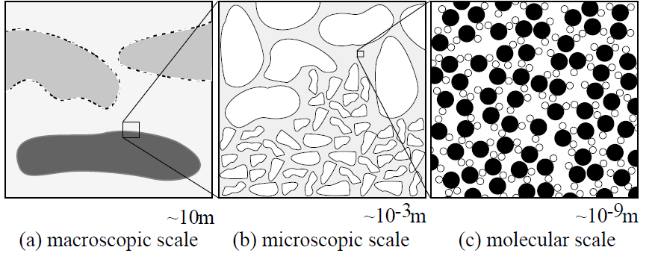
Porous Media
CONTINUUM APPROACH
The important feature in modeling porous media flow is the consideration of different length scales.
Figure 8 Different scales in a porous medium.

Slide 31
Porous Media
Fluid properties like viscosity, density, binary diffusion coefficient and miscibility are determined on the molecular scale by the individual properties of the molecules.
On the microscopic scale the configuration of the void space influences the flow behavior through properties like the tortuosity of the flow channels or the pore size distribution, whereas on the macroscopic scale the large scale inhomogeneity plays a role.
The continuum approach is a valid approximation if the mean free path length of the fluid molecules is much smaller than the physical domain of interest.

Slide 32
Porous Media
Accordingly, the flow of a single newtonian fluid in the void space of a porous medium is described on the microscopic level by the Navier–Stokes system of equations with appropriate boundary conditions.
In order to derive a mathematical model on the macroscopic level another continuum is considered.
Each point in the continuum on the macroscopic level is assigned average values over elementary volumes of quantities on the microscopic level.

Slide 33
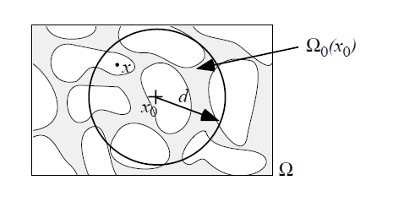
Porous Media
REPRESENTATIVE ELEMENTARY VOLUME
The averaging process used for passing from the microscopic to the macroscopic level is illustrated for the porosity, a simple geometric property of the porous medium.
The porous medium is supposed to fill the domain Ω with volume meas Ω).Let Ω₀(x₀) belongs to Ω be a subdomain of Ω centered at the point x₀ on the macroscopic level
Figure 9 Illustration of the averaging volume.

Slide 34

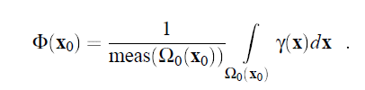
Porous Media
Further we define the void space indicator function on the microscopic level:
The porosity is given at x₀
(15)
(16)

Slide 35
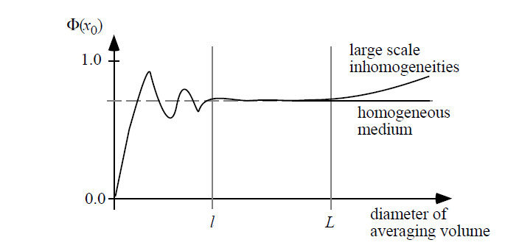
Porous Media
The macroscopic quantity porosity is obtained by averaging over the microscopic void space indicator function.
Plotting the value of Ω(x₀) at a fixed position x₀ for different diameters d of the averaging volume Ω₀(x₀).
Figure 10 Porosity Φ for different sizes of averaging volumes.

Slide 36

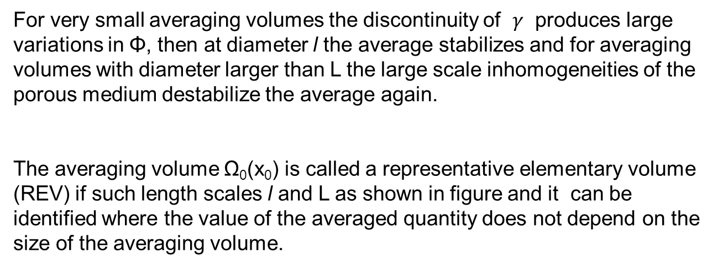
Porous Media
For very small averaging volumes the discontinuity of $γ$ produces large variations in Φ, then at diameter l the average stabilizes and for averaging volumes with diameter larger than L the large scale inhomogeneities of the porous medium destabilize the average again.
The averaging volume Ω₀(x₀) is called a representative elementary volume
(REV) if such length scales l and L as shown in figure and it can be identified where the value of the averaged quantity does not depend on the size of the averaging volume.

Slide 37
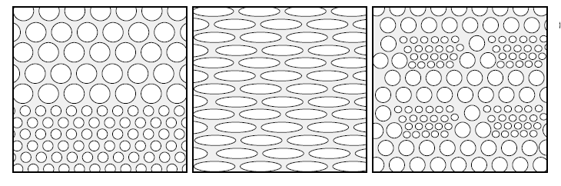
Porous Media
HETEROGENEITY AND ANISOTROPY
A porous medium is said to be homogeneous with respect to a macroscopic
(averaged) quantity if that parameter has the same value throughout the domain. Otherwise it is called heterogeneous.
Figure 11 Porous media illustrating the concepts of heterogeneity and anisotropy.

Slide 38
Porous Media
Macroscopic tensorial quantities can also vary with direction, in that case the
porous medium is called anisotropic with respect to that quantity. Otherwise
it is called isotropic.
The corresponding macroscopic quantity called permeability will be
anisotropic.

Slide 39

Porous Media
Single–Phase Fluid Flow and Transport
Consider macroscopic equations for flow and transport in porous media when the void space is filled with a single fluid.
FLUID MASS CONSERVATION
Suppose that the porous medium fills the domain then the macroscopic fluid mass conservation is expressed by the partial differential equation is given by:
(17)

Slide 40
Porous Media
In its integral form this equation states that the rate of change of fluid mass in an arbitrary control volume V belongs to Ω is equal to the net flow over the surface ∂V and the contribution of sources or sinks within V.
Φ(X): Porosity of the porous medium. It is a function of position in the case of heterogeneous media.
ρ(x; t): Density of the fluid given in [kg/m³]. The density is either
constant when the fluid is incompressible or can be assumed an equation
of state for ideal gases where density is connected to fluid pressure p = ρRT
u(x; t): Macroscopic apparent velocity in [m/s]. This velocity is obtained
by a macroscopic observer. On the microscopic level the flow takes
only place through the pore channels of the porous medium where an
average velocity of u/Φ is observed.
q(x; t) Specific source/sink term with dimensions [s⁻¹].

Slide 41

Porous Media
DARCY’S LAW
It can be shown that under appropriate assumptions the momentum conservation of the Navier–Stokes equation reduces to the Darcy–Law on the macroscopic level which is given by
This relation was discovered experimentally for the one–dimensional case by H. Darcy in 1856. It is basically a consequence of property (P3) of the porous medium.
p(x; t): Fluid pressure in [Pa] = [N/m²]. This will be the unknown function
to be determined by the flow model.
g: Gravity vector pointing in the direction of gravity with size g (gravitational
acceleration). Dimension is [m/s²].
(18)

Slide 42
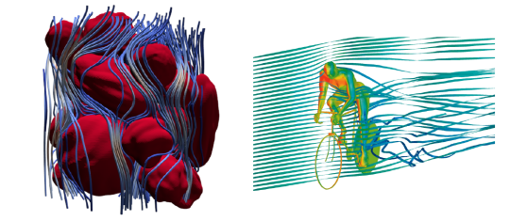
Porous Media
K(x): Symmetric tensor of absolute permeability with dimensions [m²]. It
is a parameter of the solid matrix only and may depend on position in the case of a heterogeneous porous medium. Furthermore K may be anisotropic if the porous medium has a preferred flow direction.
μ(x; t): Dynamic viscosity of the fluid given in [Pa s]. In the applications
considered here μ is either constant or a function of pressure.

Slide 43


Porous Media
Inserting equation (18) in (17) yields a single equation for the fluid pressure
with initial and boundary conditions
(19)
Dirichlet boundary, Neumann boundary,
In the case of a compressible fluid Eq. (19) is of parabolic type, in the incompressible case it is of elliptic type. (then the initial condition is not
necessary).

Slide 44
Porous Media
Microscopic Considerations of Multiphase Systems
Single–phase flow is governed by pressure forces arising from pressure differences within the reservoir and the exterior gravitational force. In multiphase flows the sharp interfaces between fluid phases on the microscopic level give rise to a capillary force that plays an important role in these flows.
Note :
1. Darcy’s Law is valid for the slow flow (inertial effects can be neglected) of a Newtonian fluid through a porous medium with rigid solid matrix.
2. No slip boundary conditions are assumed at the fluid–solid boundary on the microscopic level.

Slide 45
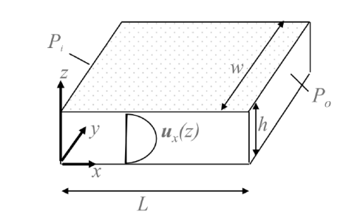
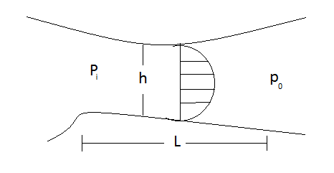
Porous Media
Viscous flow between parallel plates

Slide 46
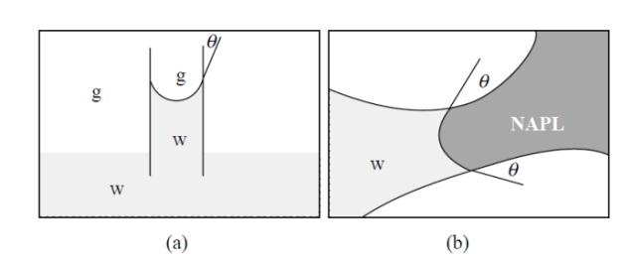
Porous Media
CAPILLARITY
Next figure shows the interface between two phases in more detail.
On the molecular level adhesive forces are attracting fluid molecules to the solid and cohesive forces are attracting molecules of one fluid to each other.
At the fluid–fluid interface these forces are not balanced leading to the curved form of the interface
Curved fluid–fluid interface due to capillarity in a capillary tube (a)
and in a porous medium (b).

Slide 47
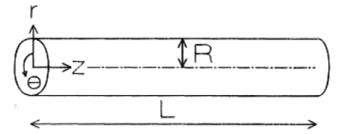

Porous Media
Viscous flow through a capillary
In cylindrical coordinates, the Stokes momentum equation becomes

Slide 48

Porous Media
Wettability.
The magnitude of the adhesive forces is decreasing rapidly with
distance to the wall. The interaction with the cohesive forces leads to a specific contact angle θ between the solid surface and the fluid–fluid interface that depends on the properties of the fluids.
Surface Tension.
The cohesive forces are not balanced at a fluid–fluid interface.
Molecules of the wetting phase fluid at the interface experience a net attraction towards the interior of the wetting phase fluid body.
This results in the curved form of the interface.
In order to move molecules from the interior of the wetting phase to the interface and therefore to enlarge its area work has to be done.
The ratio of the amount of work ΔW necessary to enlarge the area of the interface by ΔA is called surface tension
(20)

Slide 49

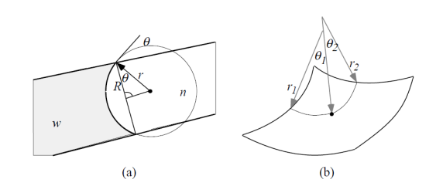
Porous Media
CAPILLARY PRESSURE
The curved interface between a wetting phase w and a non–wetting phase n is maintained by a discontinuity in microscopic pressure of each phase. The height of the jump is called capillary pressure pc:
Capillary pressure in a tube (a), principal radii of curvature (b).

Slide 50



Porous Media
In order to derive a relation for the capillary pressure, it considers a tube with radius diameter 2R (R not too large) that is filled with a wetting phase and a non–wetting phase
The radii r and R are related by R = r cosθ, Now imagine an infinitesimal increase of the radius r by dr. The work required to increase the area of the interface is given by:
This work is done by capillary pressure which is assumed to be uniform over
the entire interface:
(21)
(22)

Slide 51


Porous Media
Equating these two expressions yields an expression for capillary pressure:
Surface tension and contact angles are fluid properties whereas R is a parameter of the porous medium.
According to (23) capillary pressure increases with decreasing pore size diameter.
Similar arguments relate capillary pressure at a point of the interface to
surface tension and the principal radii of curvature at this point (also called
Laplace’s equation):
(23)

Slide 52
Darcy´s Law

Slide 53
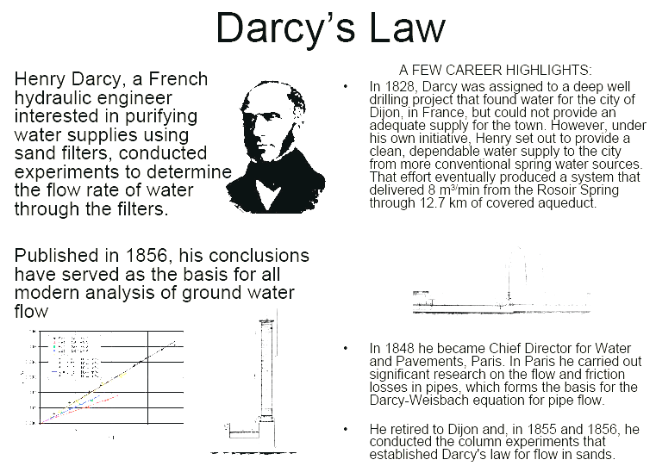

Slide 54
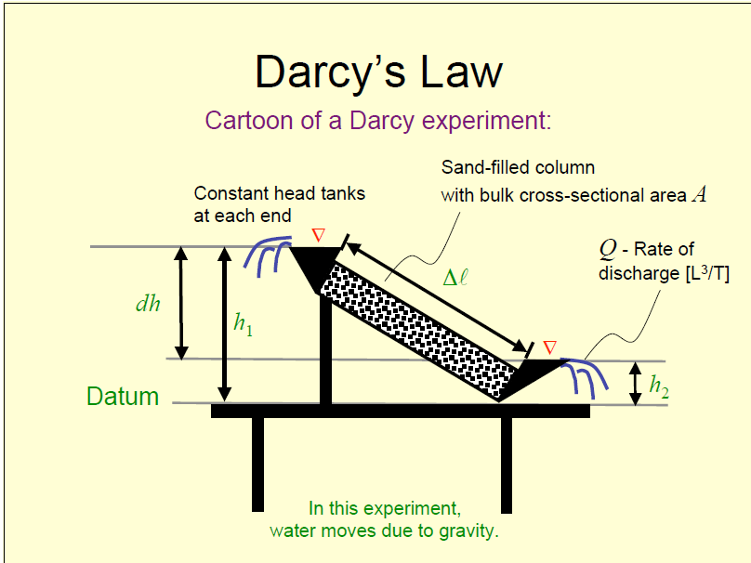

Slide 55
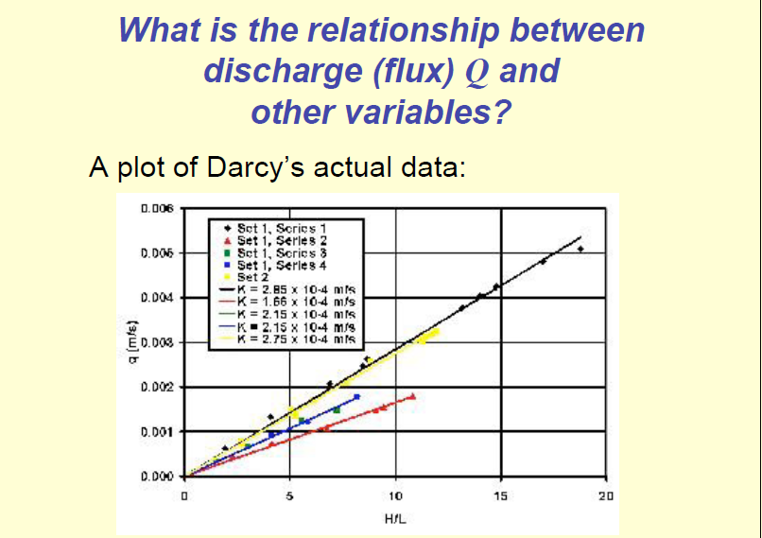

Slide 56

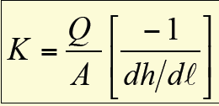
Darcy also found that if he used different kinds of sands in the column, discharge Q changed, but for a particular sand, regardless of Q:
Invert Darcy’s Law to express conductivity in terms of discharge, area, and gradient:

Slide 57
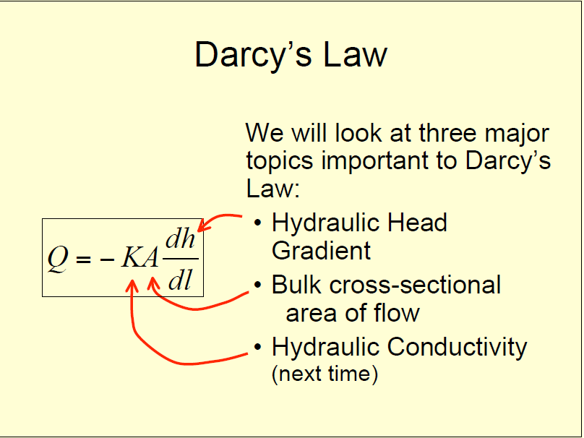

Slide 58
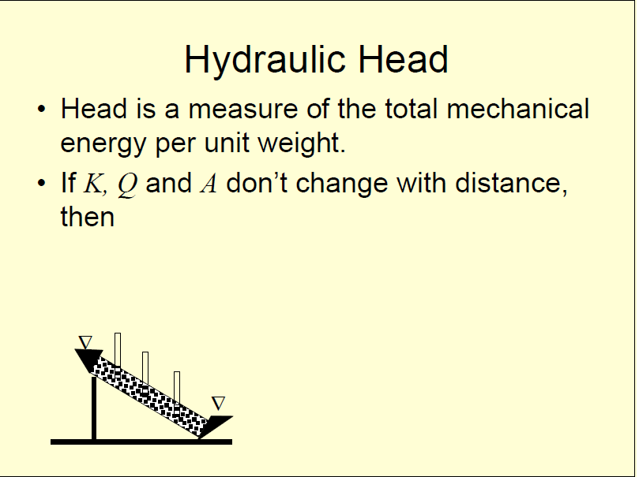

Slide 59
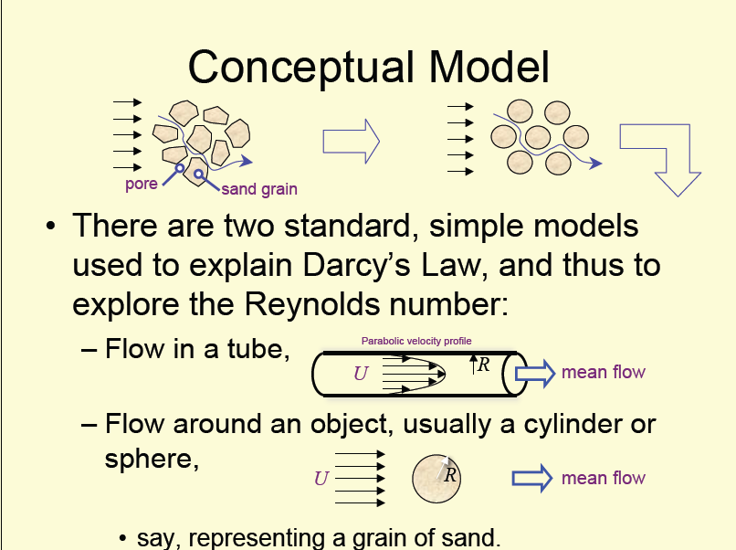

Slide 60
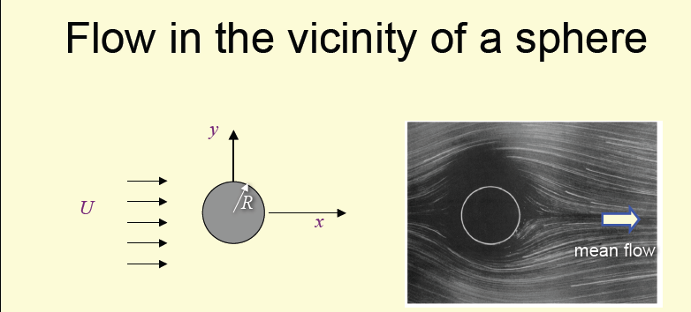

Slide 61
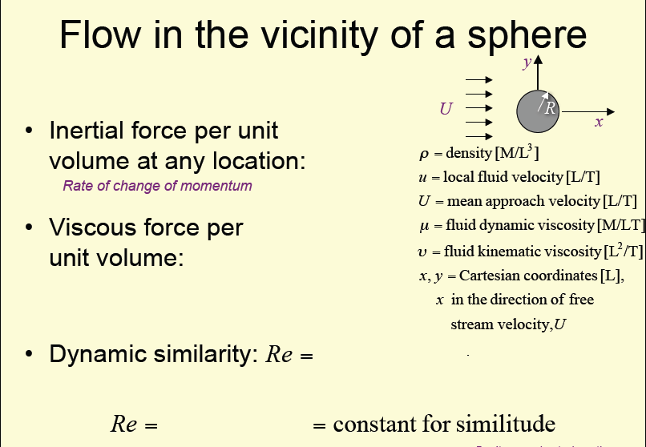

Slide 62
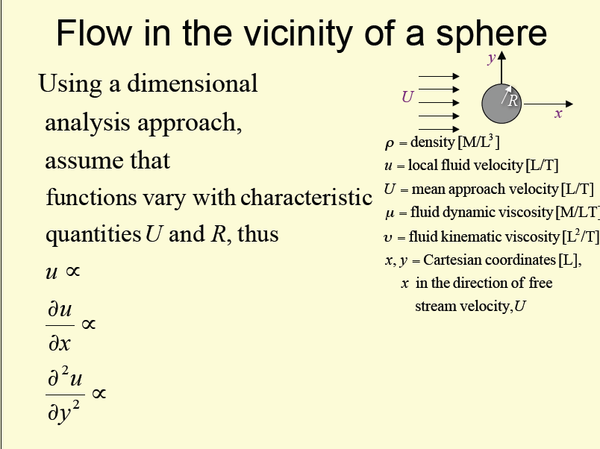

Slide 63
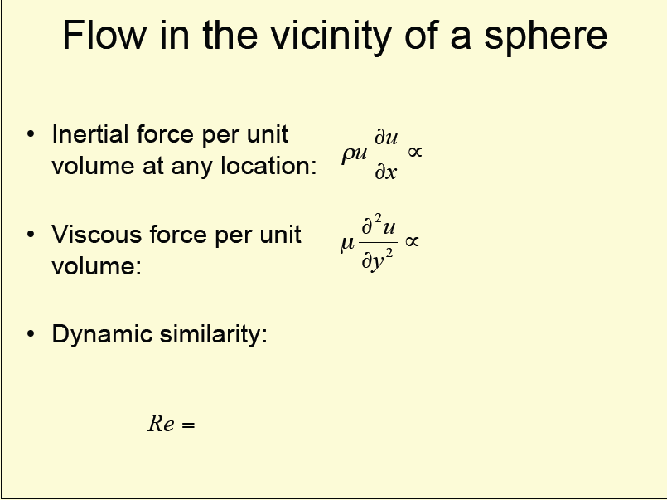

Slide 64
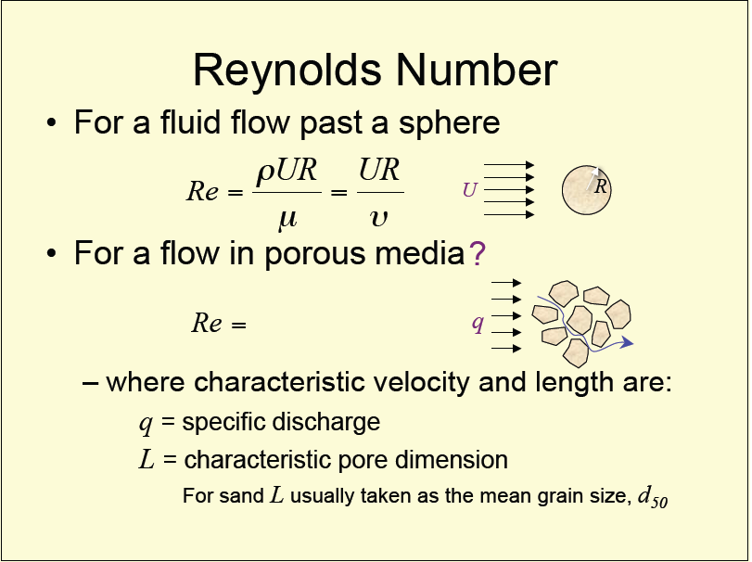

Slide 65
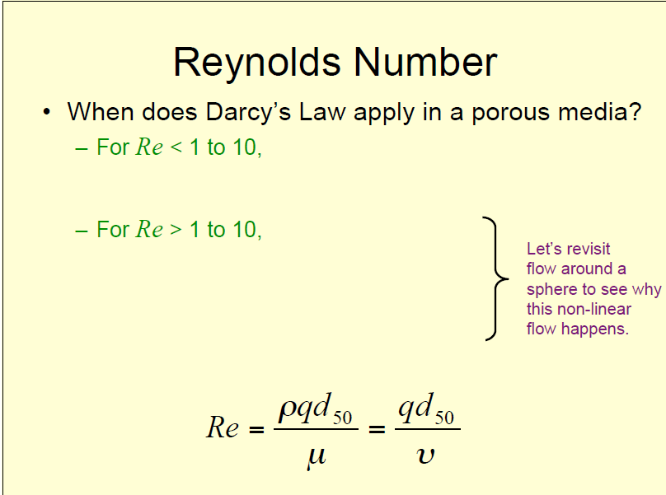

Slide 66
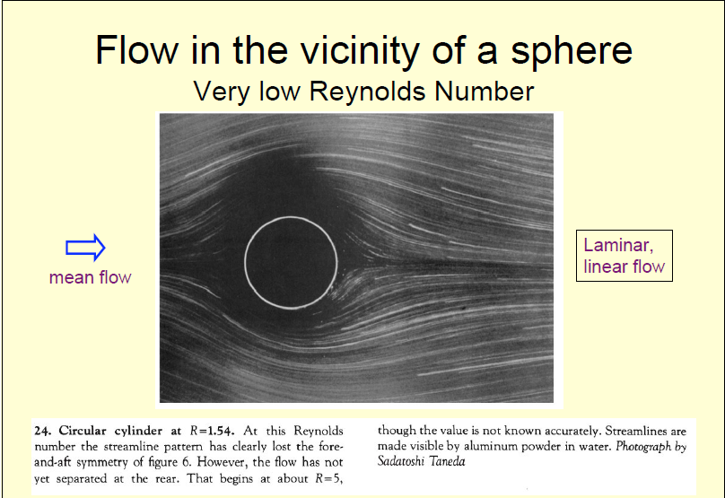

Slide 67
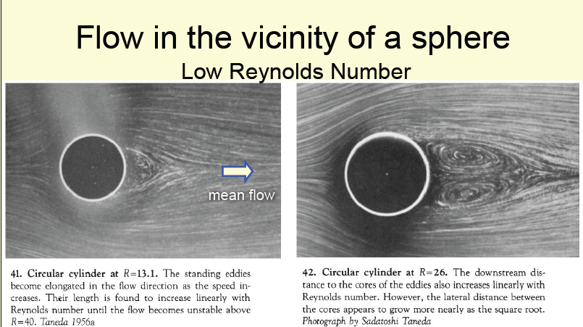

Slide 68
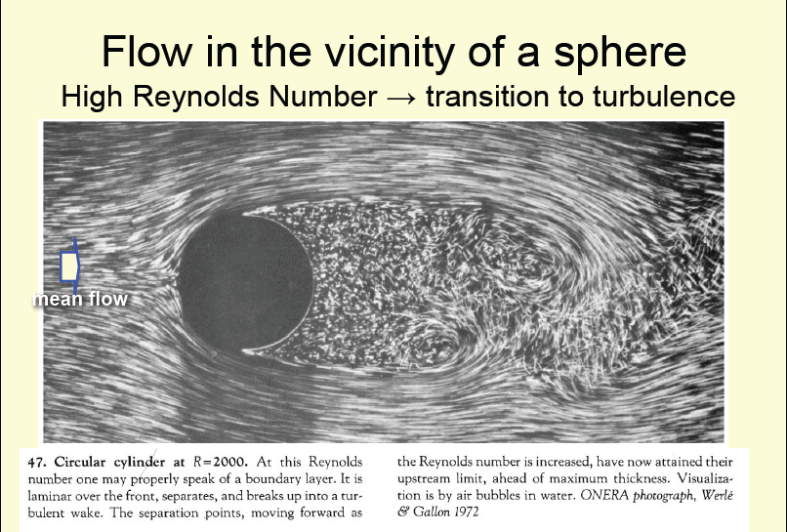

Slide 69
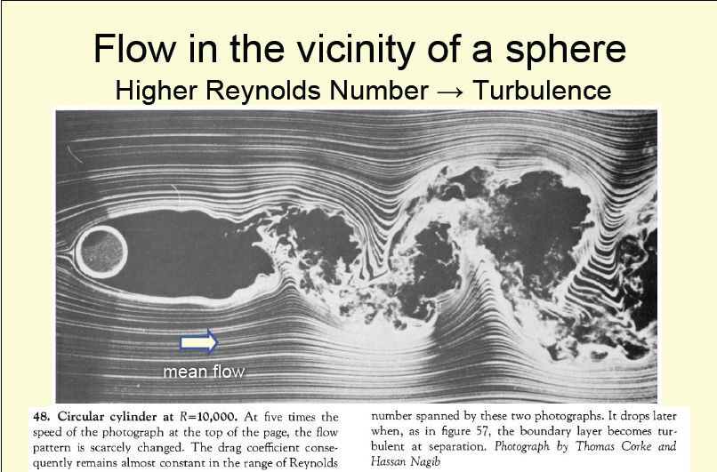

Slide 70
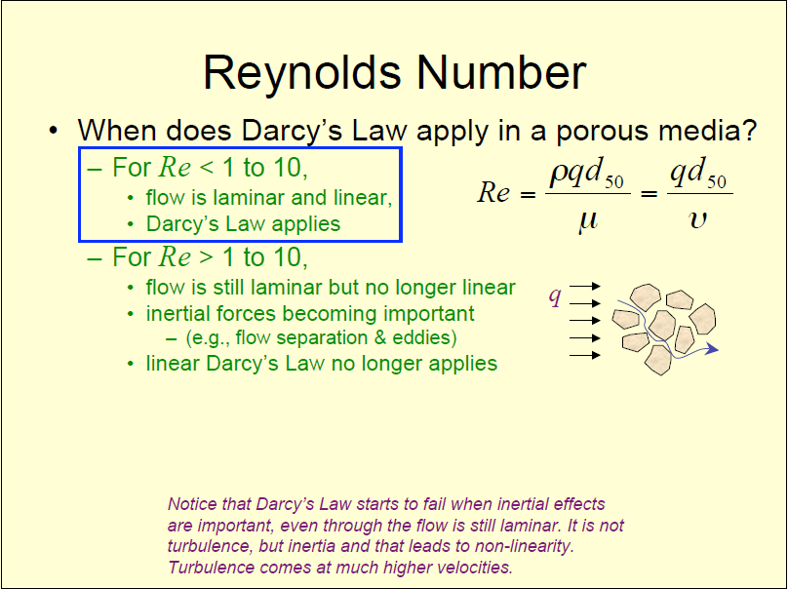

Slide 71
